Slide 1
OOP Class Relationships

Slide 2
Type Based Relationships
Type based relationships are characterized by how two classes are related to each other through ontological hierarchy.

Slide 3
Type Based Relationships
There are two type based relationships (there can be an extra one which is a type relationship that is sort of a hybrid of the two).
Realization
Specialization
(Abstract class)

Slide 4
Realization
A realization relationship is a one way relationship that describes how something abstract is REALized by something concrete.

Slide 5
Realization (other names)
Realization – Abstraction. A realization realizes an abstraction
Implementation – Interface. An implementation implements an interface

Slide 6
Abstraction
An `Abstraction` is a special type of class that does not contain any implementation.
This means that an `Abstraction` doesn't have code that controls the form and behavior of the class

Slide 7
Abstraction
An `Abstraction` is a special type of class that does not contain any implementation.
This means that an `Abstraction` doesn't have code that controls the form and behavior of the class

Slide 8
Abstraction
An abstraction can only be useful if some other class realizes this abstraction.
These `Realization` classes provide abstractions their form and behavior.

Slide 9
What's the point in maintaining some realization relationship between classes? If abstractions can only be used through their realizations , then why create the abstraction at all?

Slide 10
Realization’s importance
The importance of this seemingly pointless relationship lies in OOP's data hiding principle

Slide 11
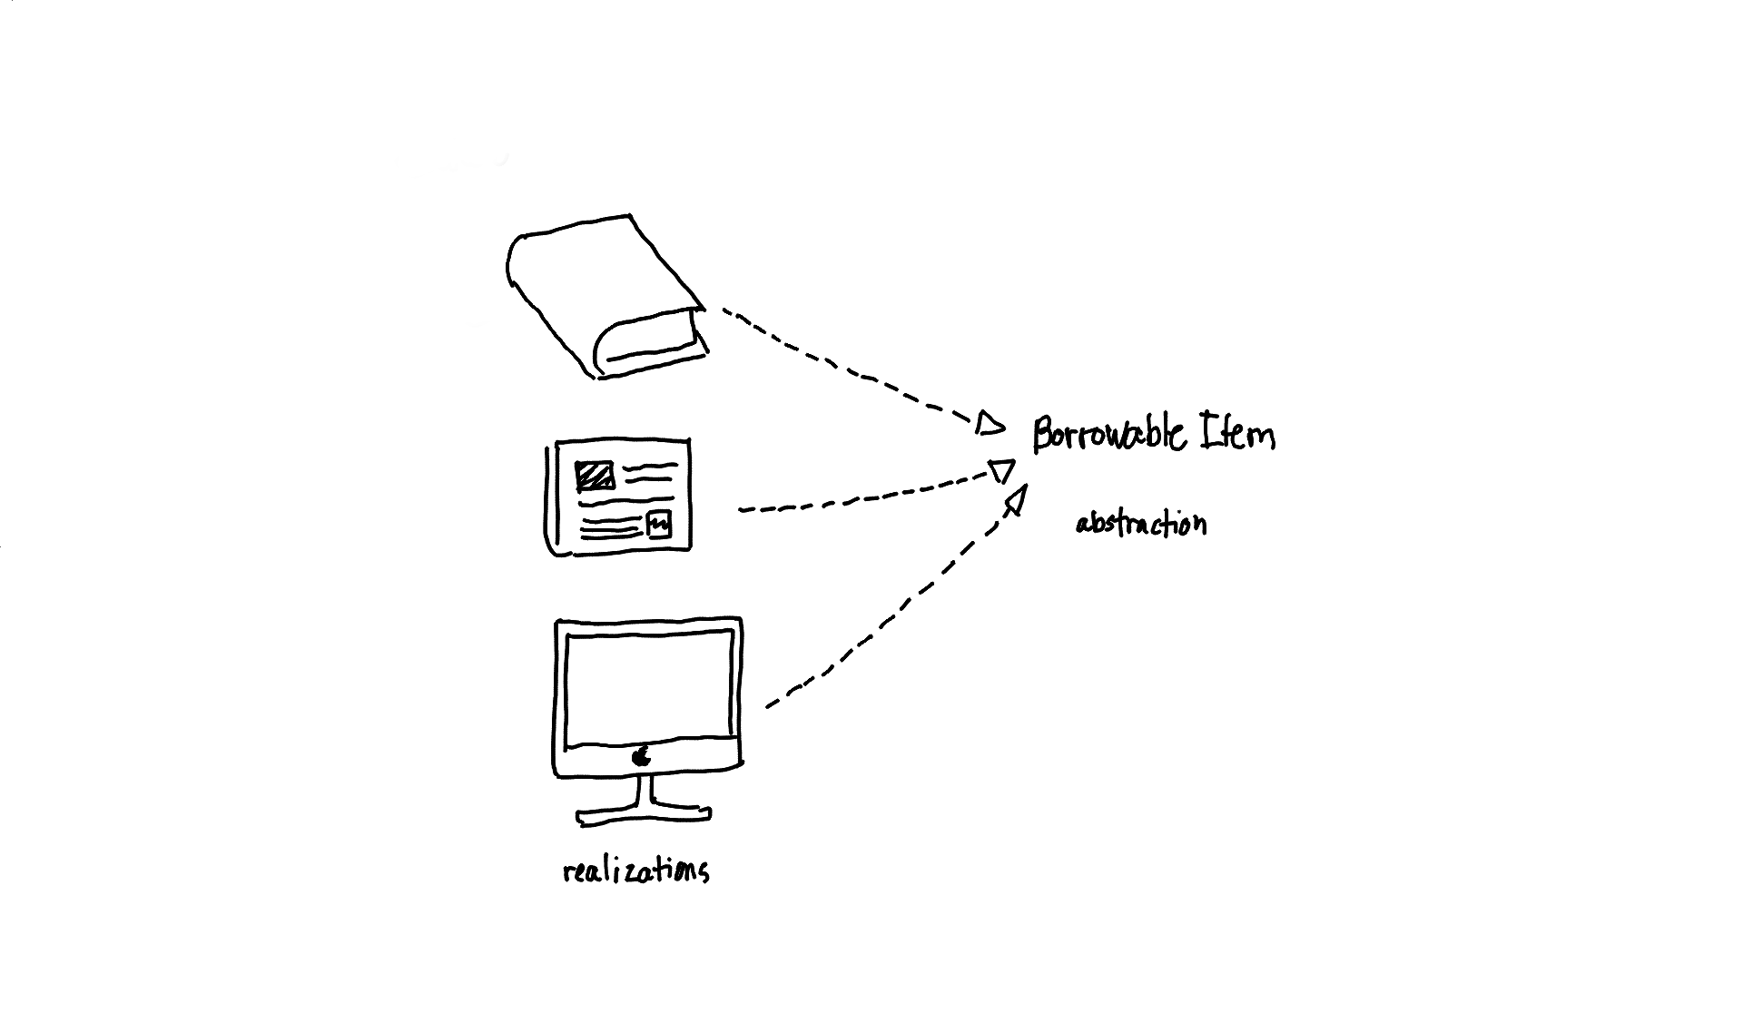

Slide 12
Realizing BorrowableItem
Any realization of `BorrowableItem`, such as `Book` or `Periodical` will be forced to implement the `borrow()` and `return()` methods

Slide 13
Realization and Polymorphism
A `Book` is a `BorrowableItem`, allowing the library system to interact with it like any `BorrowableItem`.
But at the same time `Book` is a book so it behaves in the manner a book behaves.

Slide 14
Realization
By building all these relationships, the library system is able interact with resources without explicitly knowing which exact resource it is.

Slide 15
Realization
through the establishment of these relationships, OOP is able to uphold one of its core design principles, data-hiding.

Slide 16
Specialization
Specialization relationships are very similar to realization relationships.
You can think of these specialization relationships as realizations but between two real/concrete classes.

Slide 17
Specialization (other names)
Specialization relationships are sometimes called extension relationships
Child – Parent. Child class inherits parent class
Sub Class – Super Class. Sub class extends super class

Slide 18
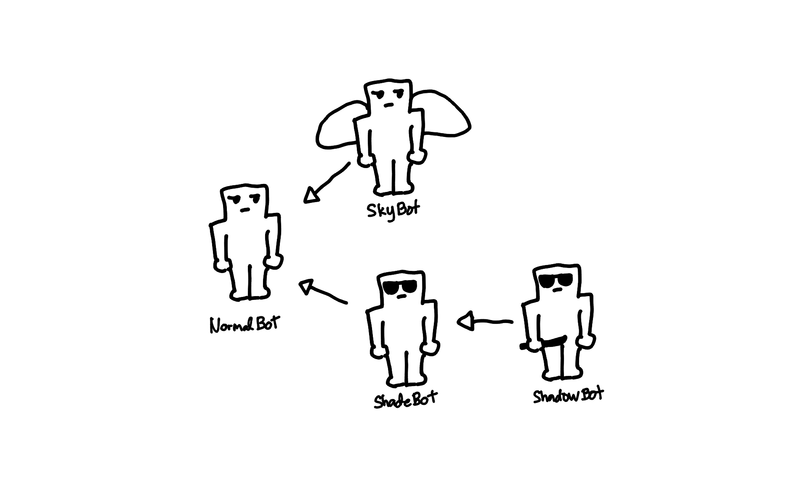

Slide 19
Specialization inheritance
Specialization relationships enable one of OOP’s core design principle, inheritance.

Slide 20
Specialization inheritance
When you write code for the general class, you do not need to rewrite it for specializations.
What you write inside specializations are the attributes and method that make it special

Slide 21
Specialization inheritance
Having one copy of code helps for maintainability.
When the recipe of all robot types need to change, the factory only needs to change the recipe of `NormalBot`, all of the special robots' recipes will change as well since they all use `NormalBot`'s recipe.

Slide 22
Specialization of Specialization
You can also specialize, specializations.
This is illustrated by `ShadowBot`, which is a special `ShadeBot` that has knife.

Slide 23
Specialization of Specialization
Since `ShadowBot` is a special `ShadeBot` and `ShadeBot` is a special `NormalBot`, `ShadowBot` is automatically a specialization of `NormalBot` as well.

Slide 24
Specialization and Polymorphism
Specializations also allow polymorphism in the same way realizations do.
A `ShadowBot` can be interacted with like any `NormalBot` or `ShadeBot` but since it is also a `ShadowBot` it will behave specifically like a `ShadowBot`.

Slide 25
Abstract Classes
An abstract class is something in between an abstraction and a generalization.
It contains attributes and methods with bodies but it also contains abstract methods as well.

Slide 26
Abstract Classes
An abstract class is something in between an abstraction and a generalization.
It contains attributes and methods with bodies but it also contains abstract methods as well.

Slide 27
Abstract Classes
When classes specialize/realize abstract classes, they inherit the attributes and methods with bodies but they are forced to implement the abstract methods as well.

Slide 28
Abstract Classes
These relationships are sometimes used if the system requires a mix of inheritance and implementation between classes.

Slide 29
Dependency Relationships
Dependency relationships, also known as associations, characterize how two classes interact with each other.
A class which is dependent on another class, needs to know how to interact with it.

Slide 30
Dependency Relationships
A dependency relationship is one way (but it is also possible for two objects to be dependent on each other).
A client class is dependent on some dependency.

Slide 31
Dependency Relationships
A dependency relationship is one way (but it is also possible for two objects to be dependent on each other).
A client class is dependent on some dependency.

Slide 32
Dependency Relationships
There are two types of dependencies
Aggregation
Composition

Slide 33
Dependency Relationships
There are two types of dependencies
Aggregation
Composition

Slide 34
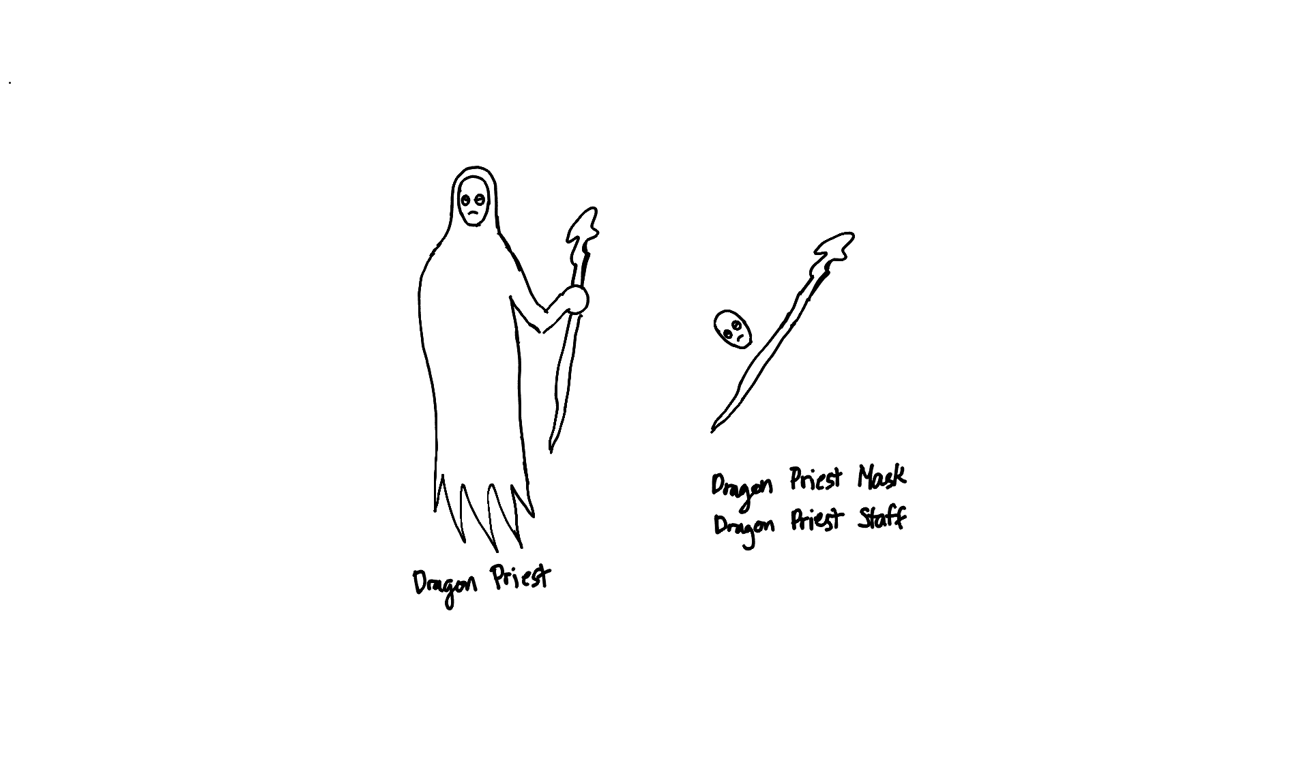

Slide 35
Aggregation
Aggregation relationships are general usage and transactional dependencies.
When a dependency is an aggregate of some client, it means that the client merely uses the instances of this dependency.

Slide 36
Aggregation
These relationships are the looser forms of dependency, because the dependency instance can exist outside the lifetime of the client instance.

Slide 37
Composition
Composition relationships are ownership dependencies.
When a client is composed of some dependency, this means that the client owns the instances of this dependency.

Slide 38
Composition
These relationships are stronger forms of dependency since the existence of the dependency instance is tied to the client, meaning, the dependency ceases to exist outside the lifetime of the client instance.

